Slide 1
Front End Engineering-II Project
TOPIC-MOVIE APP USING API
(Hulu)
Submitted By:
Janvi Sethi: 2210990431
Jasneet Singh: 2210990452
Jasleen: 2210990447
Kunal: 2210990527
Submitted To:
Dr. Vikas Patel
Dr. Baljit Kaur

Slide 2
Table of Contents
Introduction
Problem Statement
Technical Details
Key Features
Project Highlights
Conclusion
References/Links used

Slide 3
Introduction
In this project, we will be creating a movie website using API. The website will have a search bar on the left side, and the user can search the movie according to their mood. The project will include different technical details such as HTML, CSS, and JavaScript with API.

Slide 4
Problem Statement
Develop a movie API website (name MOVIEMAZE)that allows them to search for information about movies, ratings, directors, and other relevant details. The website should offer functionalities for browsing, searching, and retrieving movie-related data, including but not limited to movie details, ratings, reviews, trailers, and cast information and our login page.

Slide 5
Technical Details
The project will use HTML, CSS, and Javascript to create the Movie API Website. HTML will be used for the layout and structure of the website, while CSS will be used for styling and making the website visually appealing. Javascript will be used to implement the search function using API,to search the latest and according to your mood movie.

Slide 6
Key Features
Users should be able to search for movies by title, genre, release year, actor, director, or any other relevant criteria.
Users should be able to view ratings and reviews for each movie.
The website should provide access to trailers, teasers, and other video clips related to each movie.
The website should integrate with external APIs to enhance its functionality.
Ensure that the website is responsive and accessible across various devices and screen sizes.

Slide 7
Project Highlights
The project will showcase how to use Javascript to create an interactive Movie API website.
The project will demonstrate how to use CSS to make our page attractive and stylish.
The project will highlight how to use HTML to structure and layout the page.
The project will showcase how to implement a search bar with API fetching in a JavaScript movie website.

Slide 8
Conclusion
In conclusion, our Movie API Website offers an unparalleled gateway to the cinematic world, providing users with a search bar for exploring, discovering, and engaging with movies our platform redefines the way users interact with movies.

Slide 9
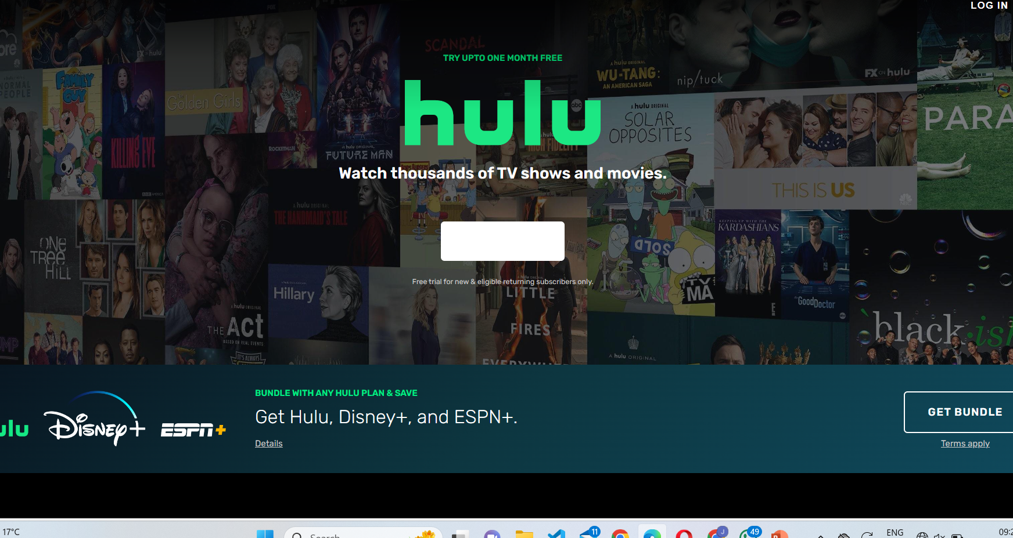
Layout of our project

Slide 10
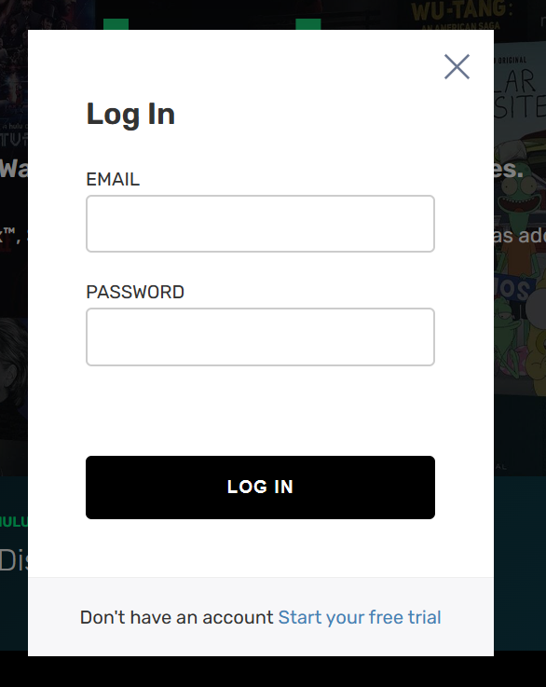
Login page

Slide 11

About our page
By clicking on know more we go to our movie search option

Slide 12
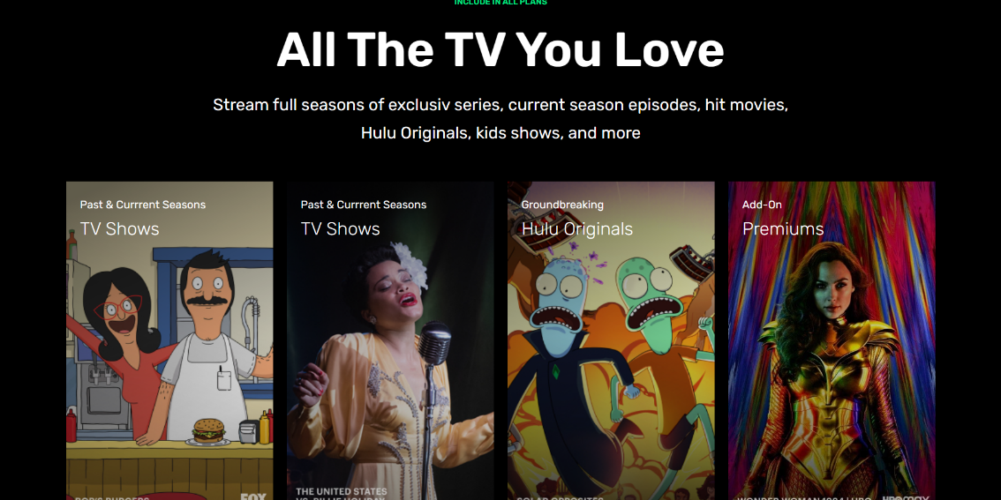

More layout

Slide 13
References/Links used
API: New tab (themoviedb.org)
W3Schools - https://www.w3schools.com/
CSS-Tricks - https://css-tricks.com/
Codecademy - https://www.codecademy.com/
Stack Overflow - https://stackoverflow.com/

Slide 14


